Slide 1
Week 4-Final Session on Design
Recap
First week Decomposition/views
Second week Patterns and Principles (section D)
Third week GUI patterns and Guideline (section B)
If lecture missed see Panopta VideoRecordingSem2
This week:
Storyboards (section C )
UI Heuristics Evaluation (may be assessed as part of the exam)
SE students have their tutorial on Tuesday 3-5 rather than normal Wednesdays, just for this week. Please all SE students come at 3:00.

Slide 2
Useful Instructions
Please attend the tutorials as part of your group.
Make sure your microphone works for tutorials, it will really help to hear you
By the end of this week you can complete Task 2
Use tutorials this week to clarify any issues for ALL of Task 2
Next week is back to GSDP
You will be having a block of software testing lectures AFTER next week as part of SECM
Software Testing is assessed as part of the exam
Please email me with constructive comments to make sessions more useful for you.

Slide 3
User interface design process (Sommerville)

Slide 4
UI design principles
UI design must take account of the needs, experience and capabilities of the system users
Designers should be aware of people’s physical and mental limitations (e.g. limited short-term memory) and should recognise that people make mistakes
Short-term memory (STM) is the second stage of the multi-store memory model proposed by the Atkinson-Shiffrin. The duration of STM seems to be between 15 and 30 seconds, and the capacity about 7 items
UI design principles underlie interface designs although not all principles are applicable to all designs

Slide 5
How to Evaluate:-An Example of Heuristic Evaluation
Affordance: the features of an object which make it self-apparent how the object should be used. Visibility: how clear the relationship between an action and its effects are to the user.
Feedback: the information that a device sends back to the user about what the user has achieved.
Interface metaphors: the metaphor helps the user to infer how to operate the program, however they are often inconsistent with their real world analogue.

Slide 6
A Simple Example of how to Evaluate
an FM radio as part of a web site
A menu: for selecting a no. of radio stations
A slider : setting volume
A field: tune to a station with an exact frequency
A pair of check boxes: switching the mute on/off
Any improvement?

Slide 7
Example (continued)
All good choices except for check boxes (should be radio buttons)
Slider is a good metaphor
To improve visibility: all the widgets need to be labelled
To improve affordance: the menu name should be highlighted as the cursor passes over, Slider needs to be raised relative to surface, the field should include a default frequency highlighted, etc.
Two very short videos to watch (last week and this week)

Slide 8
Content Awareness
All interfaces should have titles
Menus should show:
where you are
where you came from to get there
It should be clear what information is within each area
Fields and field labels should be selected carefully
Use dates and version numbers to aid system users

Slide 9
Aesthetics
Interfaces need to be functional and inviting to use
Avoid squeezing in too much
Design text carefully
Be aware of font and size
Avoid using all capital letters

Slide 10
More Aesthetics
Colours and Patterns should be used carefully
Test quality of colours by trying the interface on a black/white monitor
Use colours to separate or categorise items

Slide 11
User Experience
How easy is the system/program to learn?
How easy is the system/program to use for the expert?
Consider adding shortcuts for the experts
Where there is low employee turnover, some training can lessen the impact of less precise interfaces
training videos could be useful

Slide 12
Consistency
Enables users to predict what will happen
Reduces learning curve
Considers items within an application and across applications
Pertains to many different levels
Navigation controls
Terminology
Report and Form design

Slide 13
Minimise Effort
Three click rule
Users should be able to go from the start or main menu of a system to the information or action they want in no more than three clicks or three key strokes

Slide 14
Interface Design Prototyping
A mock-up or simulation of screen, form, or report.
Common methods include
Paper
Storyboarding
HTML
Language

Slide 15
Storyboards
tells a story of typical and untypical usage of a software system
Shows the UI in action
Uses boxes representing screens/forms/reports
shows navigation, uses specific scenarios
Can be used for prototyping UI design and useful as part of final documentation of the design
Only need to show the main usages (i.e. avoid showing login etc.)
Show different aspects of the usage of a system

Slide 16
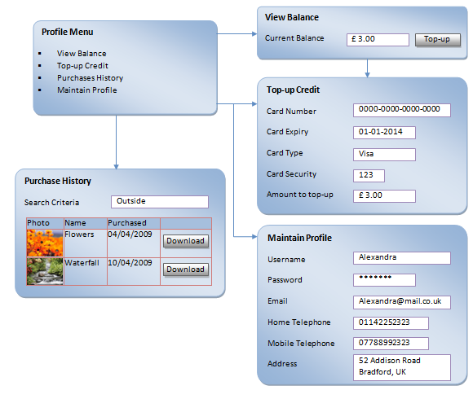
Storyboard Example

Slide 17
User Interface Design Components Navigation Design
Basic Principles
Assume users:
have not read the manual/help instructions
have not attended training
do not have external help readily at hand
All controls should be clear and understandable and placed in an intuitive location on the screen

Slide 18
More Principles
Prevent mistakes
Limit choices
Never display commands that can not be used (or "grey them out")
Confirm actions that are difficult or impossible to undo.
Simplify recover from mistakes
Use consistent grammar order,

Slide 19
Types of Navigation Control
Languages
Command language
Natural language
Menus
Generally aim at broad shallow menu
Consider using "hot keys".
Direct Manipulation
Used with icons to start programs
Used to shape and size objects
May not be intuitive for all commands

Slide 20
Input Design
Basic Principles
The goal is simply and easily capture accurate information for system
Reflect the nature of the inputs
Find ways to simplify their collection

Slide 21
Online versus Batch Processing
Online processing immediately records the transaction in the appropriate database
Batch processing collects inputs overtime and enters them into the system at one time in a batch
Batch processing simplifies data communications and other processes, but means that inventory and other reports are not accurate in real time

Slide 22
Capture data at the source
Reduces duplicate work
Reduces processing time
Decreases cost
Decreases probability of error

Slide 23
Source Data Automation
Can be obtained by using the following technologies:
bar code readers
optical character recognition
magnetic stripe reader
smart cards
How can Internet be used for source data automation?

Slide 24
Output Design
Basic Principles
Understand report usage
Reference or cover-to-cover?
Frequency?
Real-time or batch reports?
Manage Information Load
All needed information, no more
Minimise bias

Slide 25
Direct manipulation advantages
Users feel in control of the computer and are less likely to be intimidated by it
User learning time is relatively short
Users get immediate feedback on their actions so mistakes can be quickly detected and corrected

Slide 26
Direct manipulation problems
The derivation of an appropriate information space model can be very difficult
Given that users have a large information space, what facilities for navigating around that space should be provided?
Direct manipulation interfaces can be complex to program and make heavy demands on the computer system

Slide 27
Menu systems
Users make a selection from a list of possibilities presented to them by the system
The selection may be made by pointing and clicking with a mouse, using cursor keys or by typing the name of the selection
May make use of simple-to-use terminals such as touch screens

Slide 28
Advantages of menu systems
Users need not remember command names as they are always presented with a list of valid commands
Typing effort is minimal
User errors are trapped by the interface
Context-dependent help can be provided. The user’s context is indicated by the current menu selection

Slide 29
Problems with menu systems
Actions which involve logical conjunction (and) or disjunction (or) are awkward to represent
Menu systems are best suited to presenting a small number of choices. If there are many choices, some menu structuring facility must be used
Experienced users find menus slower than command language

Slide 30
Form-based interface

Slide 31
Command interfaces
User types commands to give instructions to the system e.g. UNIX
May be implemented using cheap terminals.
Easy to process using compiler techniques
Commands of arbitrary complexity can be created by command combination
Concise interfaces requiring minimal typing can be created

Slide 32
Problems with command interfaces
Users have to learn and remember a command language. Command interfaces are therefore unsuitable for occasional users
Users make errors in command. An error detection and recovery system is required
System interaction is through a keyboard so typing ability is required

Slide 33
Command languages
Often preferred by experienced users because they allow for faster interaction with the system
Not suitable for casual or inexperienced users
May be provided as an alternative to menu commands (keyboard shortcuts). In some cases, a command language interface and a menu-based interface are supported at the same time

Slide 34
Natural language interfaces
The user types a command in a natural language. Generally, the vocabulary is limited and these systems are confined to specific application domains (e.g. timetable enquiries)
NL processing technology is now good enough to make these interfaces effective for casual users but experienced users find that they require too much typing

Slide 35
Summary
The fundamental goal of navigation design is to make the system as simple to use as possible
The goal of input mechanism is to simply and easily capture accurate information
The goal of the output mechanism is to provide accurate info. to users that minimise information overload and bias

Slide 36
Summary
The user interface should be designed to make the user's work easier and more effective.
Principles for good interface design include concern for content and context for navigation through activities, aesthetic consideration, assistance for novices and experts, consistency, and minimizing user effort
The design process focuses on user actions, diagramming the structure, setting up standards and a template, then evaluating interface designs.

